Slide 1

Deloitte Pre Hire Training
2017
FOUNDATION TRAINING
ORM With Hibernate

Slide 2
ORM with Hibernate 3.5
Hibernate Architecture

Slide 3
Objectives
After completing this chapter you will be able to:
Identify an ORM architecture
Identify components in Hibernate architecture
Identify the advantage of Hibernate over JDBC
Outline annotations
Creating simple application using mapping file and annotation

Slide 4

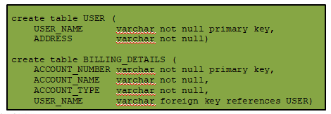
Paradigm Mismatch
Classes implement the business entity of the domain model.
Table mapped to the domain model:

Slide 5
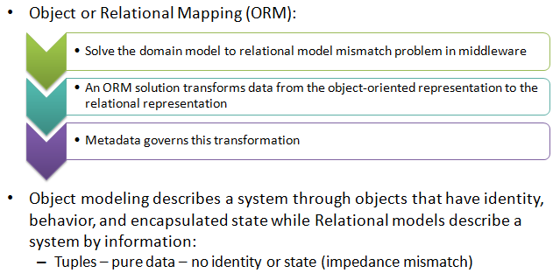
Object Relational Mapping

Slide 6
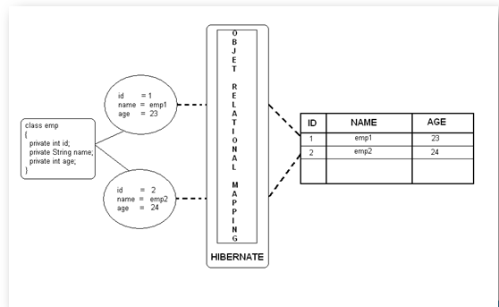
ORM Framework

Slide 7
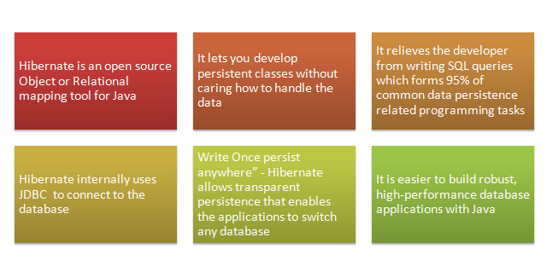
Hibernate - ORM framework

Slide 8
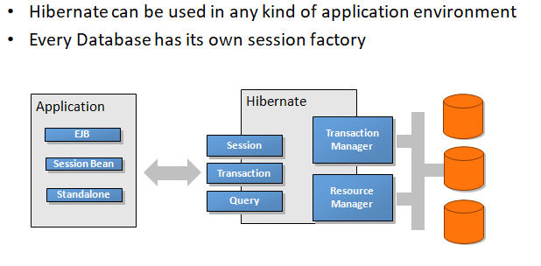
Usage of Hibernate

Slide 9
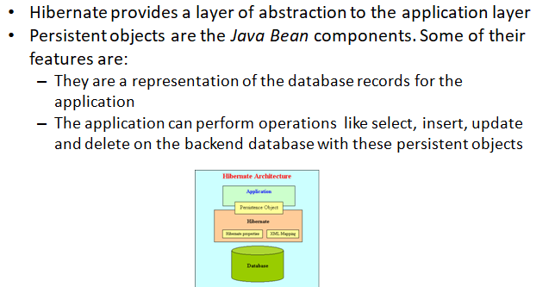
Hibernate Architecture

Slide 10
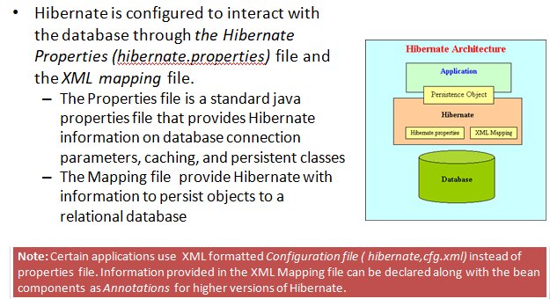
Hibernate Architecture

Slide 11
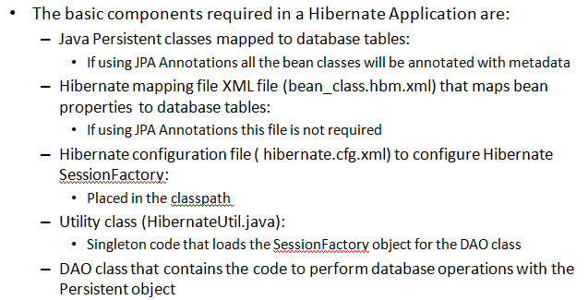
Demo: Basic Hibernate Application with Mapping File

Slide 12
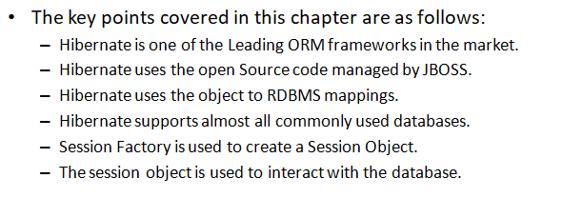
Summary

